Slide 1
Meeting Week 20
Last week summary
Augmentation
  Encoder
Parameter recovery smaller max angle difference X1 and X2 (Theta)
Outline ToDo next week

Slide 2
Last week summary
Added MSD resonance at 150hz
  Visible in FRF
  Given same input
Working on Encoder (input-output mapping)

Slide 3


Slide 4


Slide 5
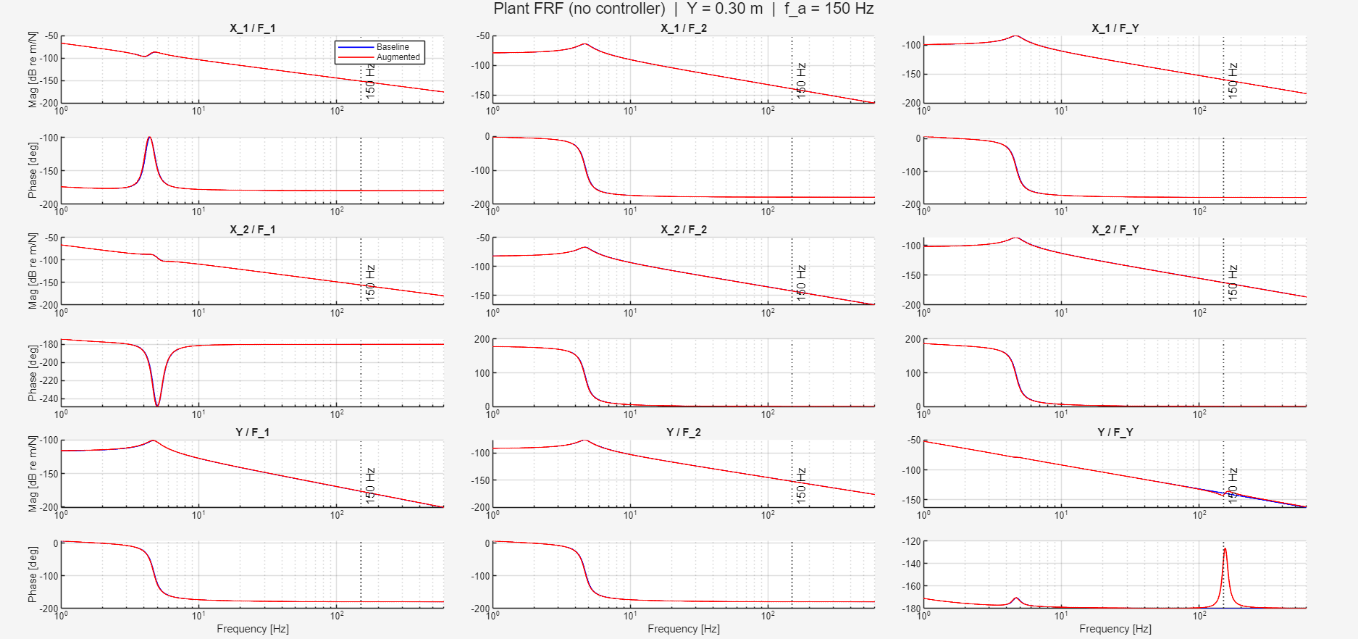

Slide 6
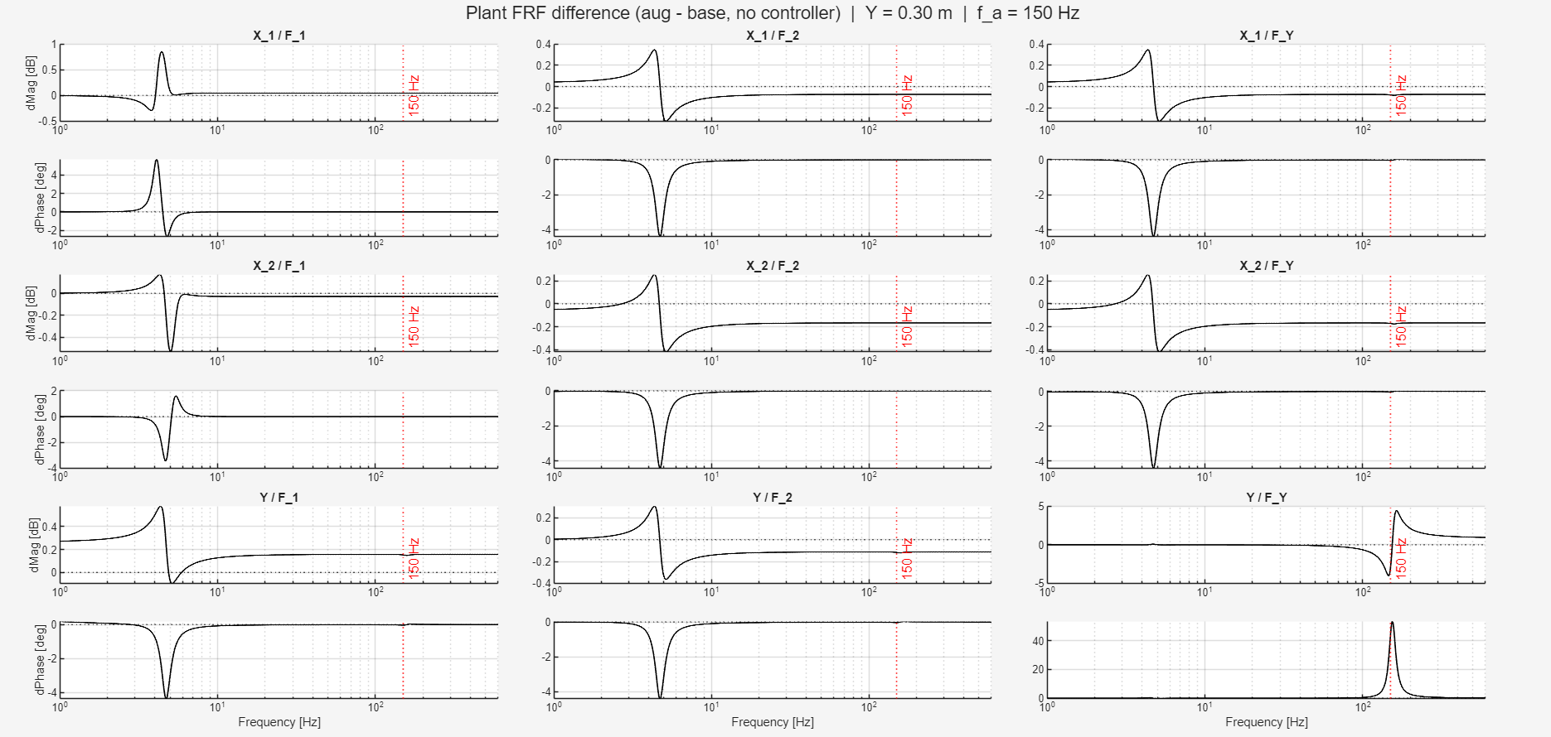

Slide 7
Error between baseline and augmented
Given the same input from closed-loop augmented system to the baseline system.
  What is the difference
Why:
  Want to know whether the baseline model given the input from the augmented system

Slide 8
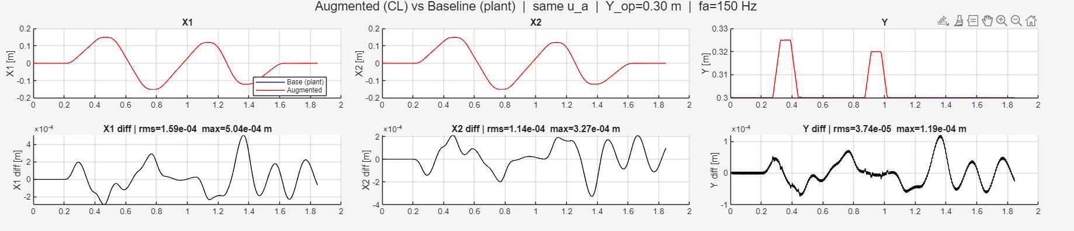
System with added MSD vs system without MSD
  Used the same input, compared the difference
Parameter recovery was able to get in the range e^-7
  With perfect parameters / perfect model is able to get in that range
  We have no noise currently

Slide 9
What is the encoder?
neural network that maps past I/O history (u_past, y_past) to an initial state x0
x0 contains both physical states (positions, velocities) and
ANN augmentation states

Slide 10
Why do we need it?
BPTT training rolls out the model for i-amount of steps from an initial state x0, but we only measure outputs (positions), not the full state
Analytical alternative positions from measurements, velocities from finite differences, ANN states = 0
ANN augmentation states have no physical meaning
Notes:
is not differentiable, so gradients cannot improve x0 during training

Slide 11
Augmentation structure
x(k+1) = f_phys(x_phys, u) + f_NN(x, u)
  x is the full 8-dimensional state vector (6 physical + 2 augmented)
  x_phys is the first 6 entries of x (just the physical states, selected via S)
Physics block: known LPV gantry model (fixed, not trained)
NN correction: feedforward network, zero-initialised (starts as pure physics)
State = 6 physical + 2 augmented
Output: y = C x_phys + D u (known, not trained)

Slide 12
Parameter justification
FRF
Chosen parameters

Slide 13
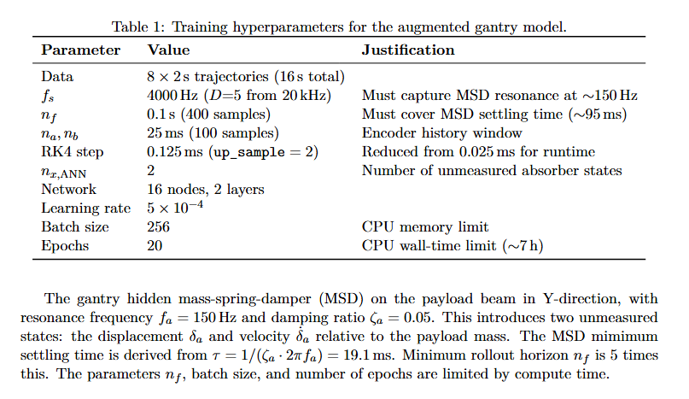
Parameter justification

Slide 14
Hybrid encoder
Baseline encoder couldn’t outperform analytical baseline for data with MSD
  Analytical baseline compute positions and velocities directly from output data
What the hybrid encoder does:
  Splits the job in two:
    Physical states (x_{1:6}): computed analytically. Detached from the computation graph so no gradients flow through them
    Augmented states (x_{7:8}): a small zero-init ANN learns these from the same past window
Trajectories not informative enough? → added multisine

Slide 15
Hybrid encoder + Multisine
Baseline encoder couldn’t outperform analytical baseline for data with MSD
  Analytical baseline compute positions and velocities directly from output data
What the hybrid encoder does:
  Splits the job in two:
    Physical states (x_{1:6}): computed analytically. Detached from the computation graph so no gradients flow through them
    Augmented states (x_{7:8}): a small zero-init ANN learns these from the same past window
Even with hybrid encoder good initialization but did not learn → data not informative enough? → added multisine to trajectories

Slide 16
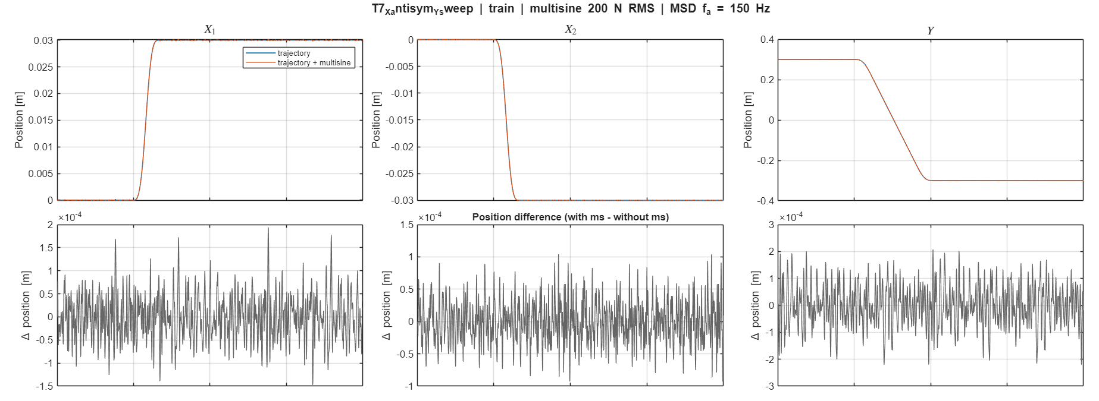

Slide 17
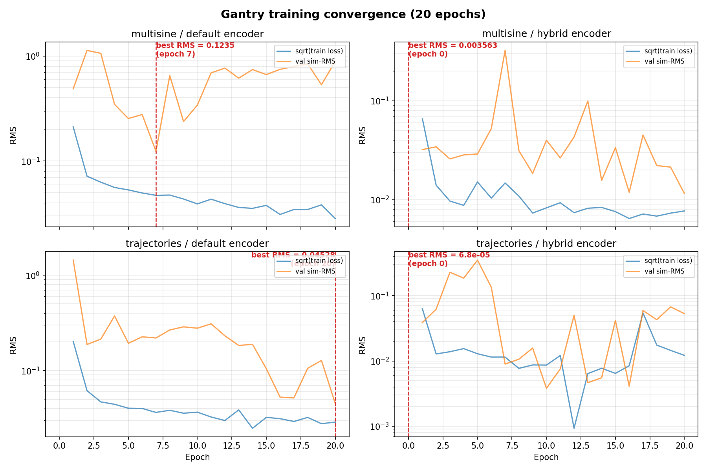
Analytical baseline order of magnitude e^-5 RMS
0.123539 RMS
0.003563 RMS
0.045276 RMS
0.000068 RMS

Slide 18
Problem with hybrid encoder
No gradients update through position and velocity states
The encoder needs to learn a mapping for I/O

Slide 19
Linear encoder initialization
Encoder weights initialized from the known baseline model
  ANN states are set to 0
  Method is for LTI so needed to choose an operating point for Y (Y=0)

Slide 20
System without MSD (Baseline)
--- BEFORE training: 20-step output prediction ---
Output 1-step NRMS 20-step NRMS
------ -------------- --------------
x1 6.4809e-05 2.6333e-04
x2 7.5406e-05 3.4315e-04
Y 2.7618e-05 8.5782e-05
Analytical 20-step output prediction:
Output 1-step NRMS 20-step NRMS
------ -------------- --------------
x1 7.5820e-06 6.3784e-05
x2 6.9332e-06 5.1355e-05
Y 5.5282e-06 4.5105e-05
--- AFTER training: 20-step output prediction ---
Output Init 1-step Trained 1-step Analytical 1-step
------ -------------- -------------- ------------------
x1 6.4809e-05 9.1409e-05 7.5820e-06
x2 7.5406e-05 1.0084e-04 6.9332e-06
Y 2.7618e-05 2.0631e-05 5.5282e-06
Output Init 20-step Trained 20-step Analytical 20-step
------ -------------- -------------- ------------------
x1 2.6333e-04 8.7203e-05 6.3784e-05
x2 3.4315e-04 9.5679e-05 5.1355e-05
Y 8.5782e-05 3.1232e-05 4.5105e-05

Slide 21
System with MSD
======================================================================
COMPARISON: Physical state NRMS
======================================================================
State NX_ANN=0 NX_ANN=2 Analytical
-------- -------------- -------------- -------------- ----------
X 2.9443e-04 2.8072e-04 0.0000e+00
theta 7.9312e-04 6.9085e-04 0.0000e+00
Y 2.2891e-04 1.0591e-04 0.0000e+00
dX 5.2102e-02 9.3972e-03 6.6885e-03
dtheta 1.4753e-01 3.2553e-01 9.5385e-02
dY 3.7484e-02 4.1815e-02 1.0123e-02

Slide 22
Parameter recovery
Max angle 0.006 meters previously 0.072 meters
Motion profiles no multisine
Slides compare results
  Left “original” 0.072 meters (best epoch 660)
  Right 0.006 meters (best epoch 660)

Slide 23
[Training]
Traj RMSE [m] X1 [m] X2 [m] Y [m]
------ ------------ ---------- ---------- ----------
T1 2.3363e-07 4.7875e-10 4.4967e-10 4.0467e-07
T2 1.8340e-07 2.2466e-07 2.2457e-07 4.8999e-10
T3 1.8342e-07 2.2476e-07 2.2451e-07 1.1326e-09
T4 1.0077e-08 1.0706e-08 1.3624e-08 2.0930e-09
T5 2.1265e-07 1.5083e-07 1.5055e-07 3.0041e-07
T6 2.6837e-07 1.4659e-09 1.5980e-09 4.6482e-07
T7 2.5686e-07 1.0754e-08 1.3987e-08 4.4454e-07
T8 2.0804e-07 1.4032e-07 1.3801e-07 3.0184e-07
Train RMSE: 2.087048e-07 m
[Training]
Traj RMSE [m] X1 [m] X2 [m] Y [m]
------ ------------ ---------- ---------- ----------
T1 9.8580e-08 4.9997e-08 4.8472e-08 1.5590e-07
T2 7.7395e-07 9.4786e-07 9.4792e-07 2.6151e-09
T3 7.7403e-07 9.4815e-07 9.4783e-07 3.9236e-09
T4 3.4861e-07 4.6253e-07 3.6898e-07 1.2043e-07
T5 5.0220e-07 6.0797e-07 6.1185e-07 1.1240e-07
T6 1.6992e-07 1.5966e-07 1.7504e-07 1.7462e-07
T7 3.1902e-07 3.6804e-07 3.5306e-07 2.1266e-07
T8 6.5265e-07 7.8215e-07 8.0278e-07 1.4712e-07
Train RMSE: 5.169837e-07 m

Slide 24
[Validation]
Traj RMSE [m] X1 [m] X2 [m] Y [m]
------ ------------ ---------- ---------- ----------
V1 1.6160e-07 1.1340e-07 1.1322e-07 2.2948e-07
Val RMSE: 1.615967e-07 m
[Test]
Traj RMSE [m] X1 [m] X2 [m] Y [m]
------ ------------ ---------- ---------- ----------
E1 1.2995e-07 8.5397e-08 8.3640e-08 1.9072e-07
Test RMSE: 1.299505e-07 m
[Validation]
Traj RMSE [m] X1 [m] X2 [m] Y [m]
------ ------------ ---------- ---------- ----------
V1 3.6852e-07 4.4564e-07 4.4871e-07 8.6497e-08
Val RMSE: 3.685197e-07 m
[Test]
Traj RMSE [m] X1 [m] X2 [m] Y [m]
------ ------------ ---------- ---------- ----------
E1 3.7594e-07 4.4753e-07 4.6311e-07 9.6125e-08
Test RMSE: 3.759383e-07 m

Slide 25
================================================
Step 5: Parameter recovery
============================================================
Table 1 — identifiable quantities
Parameter True Detuned Learned delta
-------------------------------------------------------
kb_sum 3975.0000 4372.5000 3974.9998 -0.00%
cg1 14.5000 15.9500 14.5000 -0.00%
cg2 20.3000 18.2700 20.2999 -0.00%
cy 10.0000 11.0000 10.0000 -0.00%
cb_sum 18.0000 16.2000 17.9999 -0.00%
mh 10.1000 9.0900 10.1000 -0.00%
m_total 43.7000 45.9300 43.6999 -0.00%
m_diff -0.5000 1.5900 -0.5000 -0.00%
J_eff 3.7964 3.6848 3.7964 -0.00%
d 0.1000 0.1100 0.1000 +0.00%
================================================Step 5: Parameter recovery
============================================================
Table 1 — identifiable quantities
Parameter True Detuned Learned delta
-------------------------------------------------------
kb_sum 3975.0000 4372.5000 3975.0388 +0.00%
cg1 14.5000 15.9500 14.4996 -0.00%
cg2 20.3000 18.2700 20.2997 -0.00%
cy 10.0000 11.0000 10.0000 -0.00%
cb_sum 18.0000 16.2000 18.0769 +0.43%
mh 10.1000 9.0900 10.1000 -0.00%
m_total 43.7000 45.9300 43.7001 +0.00%
m_diff -0.5000 1.5900 -0.5000 +0.01%
J_eff 3.7964 3.6848 3.7939 -0.07%
d 0.1000 0.1100 0.1000 -0.01%

Slide 26
Table 2 — split diagnostics (not data-identifiable)
Parameter True Detuned Learned delta
-------------------------------------------------------
kb1 1987.5000 2186.2500 1987.4999 -0.00%
kb2 1987.5000 2186.2500 1987.4999 -0.00%
cb1 9.0000 8.1000 9.0000 -0.00%
cb2 9.0000 8.1000 9.0000 -0.00%
Jb 1.0000 0.9000 0.9369 -6.31%
Jh 0.0500 0.0450 0.0468 -6.31%
m1 10.2000 11.2200 10.4520 +2.47%
m2 10.7000 9.6300 10.9520 +2.36%
mb 22.8000 25.0800 22.2959 -2.21%
J_sum 1.0500 0.9450 0.9838 -6.31%
Table 2 — split diagnostics (not data-identifiable)
Parameter True Detuned Learned delta
-------------------------------------------------------
kb1 1987.5000 2186.2500 1987.5194 +0.00%
kb2 1987.5000 2186.2500 1987.5194 +0.00%
cb1 9.0000 8.1000 9.0385 +0.43%
cb2 9.0000 8.1000 9.0385 +0.43%
Jb 1.0000 0.9000 0.9312 -6.88%
Jh 0.0500 0.0450 0.0466 -6.88%
m1 10.2000 11.2200 10.4651 +2.60%
m2 10.7000 9.6300 10.9651 +2.48%
mb 22.8000 25.0800 22.2698 -2.33%
J_sum 1.0500 0.9450 0.9778 -6.88%

Slide 27
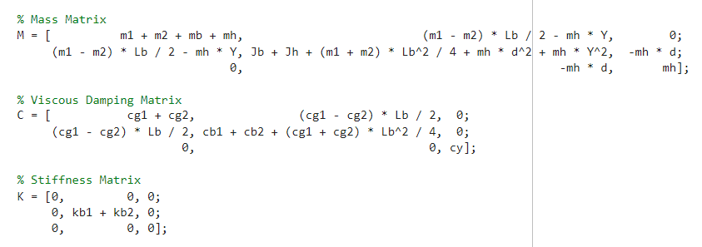

Slide 28
X, Theta, Y
Most affected cb_sum and J_eff → makes sense that these are the most affected in the theta row

Slide 29
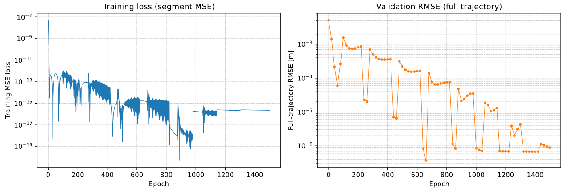

Slide 30
Outline next week
Wednesday joint meeting ASMPT-TU/e
  Overview of where we are now in the overall process
Further work on encoder and augmentation

Slide 32
--- BEFORE training: 20-step output prediction ---
Output 1-step NRMS 20-step NRMS
------ -------------- --------------
x1 6.4809e-05 2.6333e-04
x2 7.5406e-05 3.4315e-04
Y 2.7618e-05 8.5782e-05
--- AFTER training: 20-step output prediction ---
Output Init 1-step Trained 1-step Analytical 1-step
------ -------------- -------------- ------------------
x1 6.4809e-05 9.1409e-05 7.5820e-06
x2 7.5406e-05 1.0084e-04 6.9332e-06
Y 2.7618e-05 2.0631e-05 5.5282e-06
Output Init 20-step Trained 20-step Analytical 20-step
------ -------------- -------------- ------------------
x1 2.6333e-04 8.7203e-05 6.3784e-05
x2 3.4315e-04 9.5679e-05 5.1355e-05
Y 8.5782e-05 3.1232e-05 4.5105e-05

Slide 33
Velocity error dominates in the current position loss, because..
Because of that try state loss instead of only position based loss

Slide 34
Determine slowest dynamics
In python: gantry_linearization.py
probably better off doing this in matlab…

Slide 35
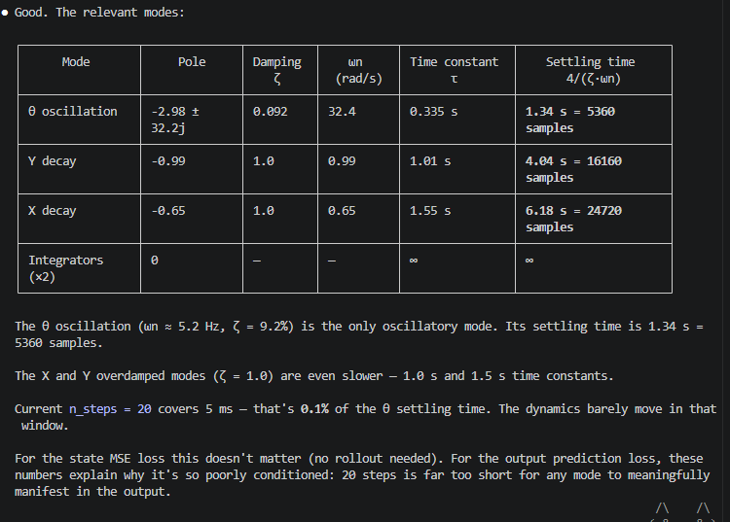
Sample lengths n_steps / nf

Slide 36
